Slide 1
Green Recovery – Delivering the Green Deal . Slide deck for the MFF Hub
Project financed by the European Climate Foundation - europeanclimate.org
Ingmar Jürgens
Ingmar@climcom.de
Malte Hessenius
Malte@climcom.de
Stefanie Berendsen
Stefanie@climcom.de
Climate & Company
Berlin, September 2020
Climate & Company
Climateandcompany.de
Ahornallee 2, 12632 Berlin
Notes:
This slide deck was created by Climate & Company as part of the joint project with Frankfurt School and Germanwatch, financed by the European Climate Foundation. It shall provide arguments for 1) an operation of the DNSH principle, 2) the Taxonomy as a science-based monitoring tool and 3) integrated governance.
In case of any questions, feel free reaching out to Ingmar@climcom.de, malte@climcom.de or stefanie@climcom.de

Slide 2
Outline
Introduction (Overview and Investment Needs)
How to operationalize the do no harm principle?
The EU Taxonomy as a science-based tracking tool (vs. Rio marker)
Governance

Slide 3
Delivering the Green Deal
Goal
Financing
Capacity building
Regulation & Structural Reforms
Climate neutrality and just transition
MFF and RRF
DG REFORM
European Semester: CSRs, AMR, MIP
Energy Union
Resilient recovery and competitiveness
Integrated governance for policy coherence
MFF and RRF aligned with the Green Deal
Mobilise DG Reform to support MS with green investment
Re-calibrate the European Semester for the Green Deal
Notes:
Key aspects how to deliver the Green Deal. The right mix of financing, capacity building and regulation & reforms.

Slide 4
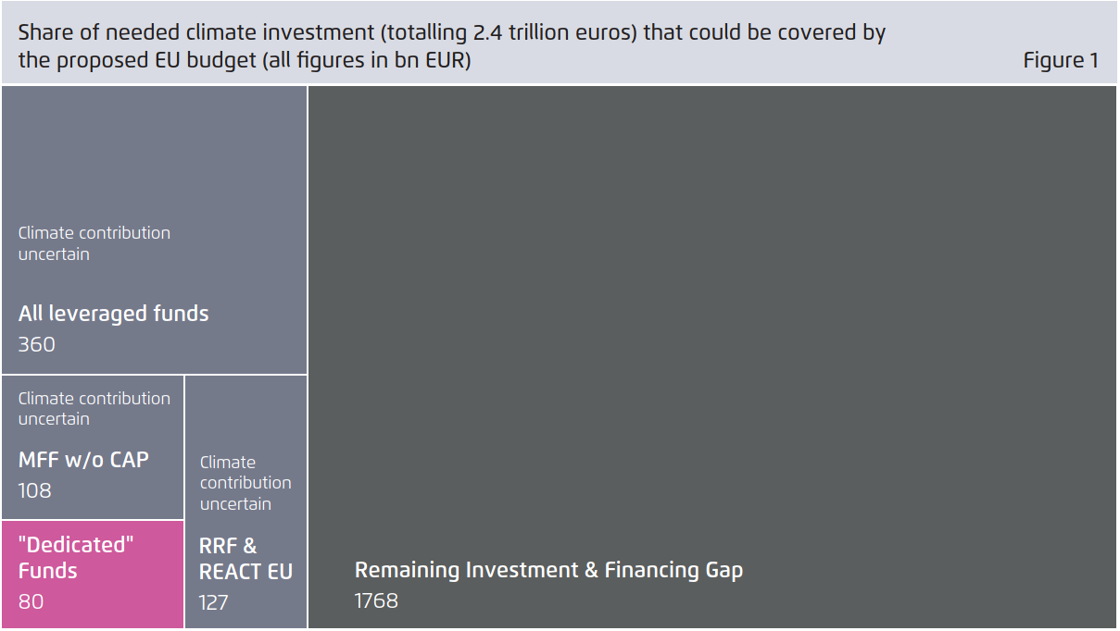
Analysis of Next Generation EU and the MFF 2021-27:¹ The 25% climate target leaves a large investment gap… (1/3)
1) Analysis based on the COM’s proposal, 27 May 2020; Figure: Juergens, I., Berendsen, S., Hessenius, M., & Rusnok, D. (2020). More info via this link.

Slide 5
… which would increase even more if the changes of the EUCO are considered… (2/3)
The volume of “climate facilities” have decrease substantially
Immediate Cash budgets
Sum of NGEU (2021-2024) and MFF (2021-27) ¹ | 27 May COM Proposal |  |  | 21 July EUCO decision
 | Grants | Guarantees | Loans | Grants | Guarantees | Loans
Large Cash budgets
RRF | 310 |  | 250 | 312.5 |  | 360
ReactEU | 50 |  |  | 47.5
Facilities with more “climate dedication”
Just Transition Fund (JTF) | 40 |  |  | 20
Invest EU |  | 31.6 |  |  | 6.9
Horizon Europe | 94.4 |  |  | 85.9
Much flexibility for MS
Large potential role, if used wisely
… all depends on governance!
Facilities with more “climate dedication”
JTF – key for transitions regions
InvestEU – taking on risks
Horizon – early stage innovation processes
From 166 bn EUR to 112.8 bn EUR!
Decrease by ~ 33%!
1) The MFF & NGEU figures from the COM’s proposal from May 27 are extracted from COM(2020) 442 final (link). The changes in NGEU figures come from the EUCO conclusions (link).

Slide 6
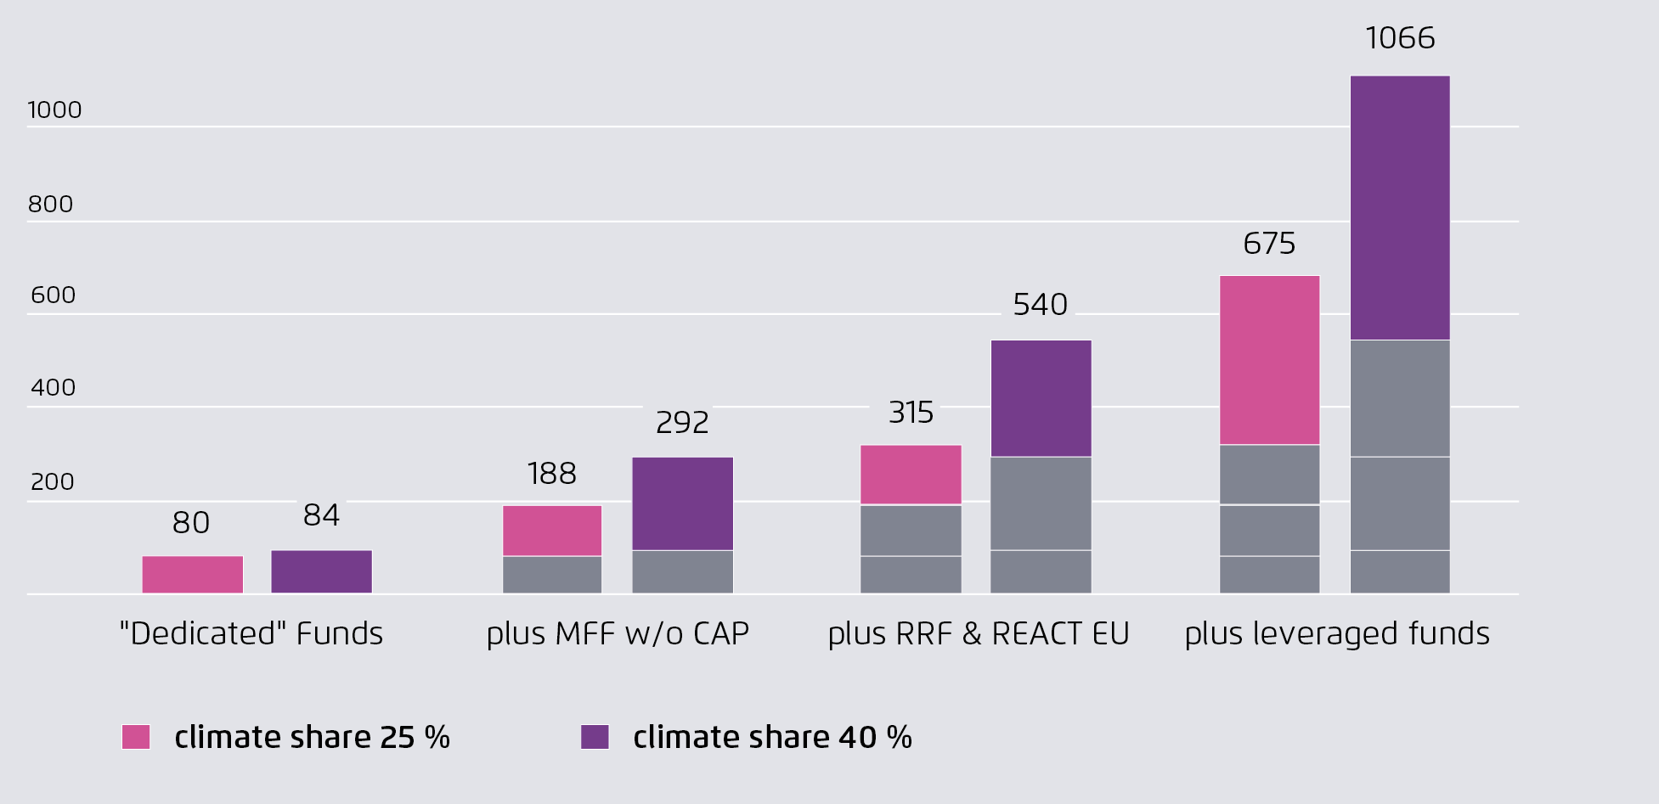
… and even if a climate share of 40% is assumed, the EU budget covers less than half of the required 2.4 trillion EUR (3/3)
1) Source: Figure 3, Agora Energiewende (2020) – Recovering better (link); Note: The 2.4 trillion EUR investment gap even stems from a lower level of ambition.
Notes:
- Even given the most optimistic scenario: climate target of 40% and in which all funds that could theoretically be used for climate investment in these sectors are actually used to this end, the EU budget would cover less than half of requires investments (based on conservative assumptions and lower level of ambition).

Slide 7
How to mobilise MFF and RRF for the green deal Do no harm principle, Taxonomy and effective governance
I
Operationalization of the do no harm principle
II
Taxonomy for carbon accounting in the EU budget
“[The MFF and NGEU] shall comply with the objective of EU climate neutrality by 2050 and contribute to achieving the Union's new 2030 climate targets, which will be updated by the end of the year. As a general principle, all EU expenditure should be consistent with Paris Agreement objectives.” (Source: EUCO conclusions; I Next Gen EU, Art 21)
“[…] EU expenditure should be consistent with Paris Agreement objectives and the "do no harm" principle of the European Green Deal […]” […]” (Source: EUCO conclusions; Annex I, paragraph 18)
“[…] An effective methodology for monitoring climate-spending and its performance, including reporting and relevant measures in case of insufficient progress, should ensure that the next
MFF as a whole contributes to the implementation of the Paris Agreement. […]” (Source: EUCO conclusions; Annex I, paragraph 18)
Apply do no significant harm principle to all budget lines. (I)
Use Taxonomy as a science-based tracking tool. (II)
III
Need for effective governance
NECPs
National Reform Plans
Policy coherence requires integrated governance! (III)
Recovery and Resilience Plans
Just Transition Plans
Notes:
The three chapters of this slide deck: 1)

Slide 8
Outline
How to operationalize the do no harm principle?
The EU Taxonomy as a science-based tracking tool (vs. Rio marker)
Governance

Slide 9
Do no harm principles exist already in MFF budget lines but are not comprehensive and inconsistent
ERDF and Cohesion Fund [COM(2018)372]
Article 6: nuclear, tobacco, airport infrastructure (except for outermost regions); disposal of waste in landfill; fossil fuels (exception of investment related to clean vehicles as stated in Art. 4, Directive 2009/33/EC)
Invest EU, Annex V [COM(2020) 403 final]
Human rights, tobacco, gambling, sex trade, …
Investments related to fossil fuels and gas, except: a) projects with no viable alternative technology, b) projects related to pollution prevention and control; c) CCS/CCU and research projects leading to substantial GHG emission reduction
Just Transition Fund, Article 5 [COM(2020) 22 final]
Nuclear, tobacco, fossil fuels, broadband infrastructure in areas with at least two networks of equivalent category

Slide 10
Ensuring “consistency with Paris Agreement objectives” through sectoral exclusion criteria A first attempt based on existing work
Industry
Energy Supply
Transport
Buildings
Agriculture / Forestry
20% of EU emissions, high risks of lock in
30% of EU emissions, key to electrify processes
22% of EU emissions
13% of EU emissions
12% of EU emissions
Production of fluorinated GHG with a Global Warming Potential (GWP) of >150¹
Chemical manufacturers unless for safe and sustainable chemicals²
No support for coal/heavy-fuel oil/ fossil gas as fuel or feedstock³
No support for electricity-intensive processes without a plan to green power sources by 2030³
GHG emissions are higher than the average global emissions for that activity⁴
Nuclear, fossil fuels, gas¹
Crop-based biofuels and unsustainable bioenergy²
No activity can have emissions intensity above the average emissions (regional)⁴
[….]
Expansion of aviation capacity and motorways²
Internal combustion engine vehicles²
LNG and diesel maritime vessels (except substantial GHG improvements)²
Fossil gas (LNG/CNG) infrastructure for transport²
All DNSH criteria from the EU Taxonomy (e.g. Emissions performance threshold of > 95g CO2 e /pkm for passenger cars)⁴
Fossil-fuel based heating appliances³
DNSH criteria from the EU Taxonomy (e.g. new building must comply with all applicable mandatory national/regional regulations regarding energy & carbon performance)⁴
[….]
Production of agricultural products on land obtained as a result of deforestation of primary forest […] after the year 2000¹
Livestock farming, unless organic or extensive (<0.7 LSU/ha)²
Timber production unless operator demonstrates that harvest is covered by valid licences and not from primary forest with high biodiversity value & carbon stock.¹
DNSH criteria from EU Taxonomy.⁴
1) As stated in the Ecolabel exclusion criteria (link );2) as suggested by the G-10 (link) ; 3) Climate & Company (2020) – Study for Agora (link); 4) Taxonomy, DNSH to objective “mitigation” (part of the climate change adaptation Taxonomy) // Note: Plus, there are overall exclusion activities by the IFC World Bank Group (link) or the KfW (link).
Notes:
An example, open for discussion, how sectoral exclusion criteria could look like. Based on already existing work (see sources), they could be operationalized relatively quickly.

Slide 11
Outline
How to operationalize DNSH?
The EU Taxonomy as a science-based tracking tool (vs. Rio marker)
Governance

Slide 12
If the climate share is not measured accurately, it cannot be effective
1
An adaptation of the Rio Markers is currently used¹
Classification | Examples
Significant (100%) | Renewable energy projects, energy efficiency measures, cycling and footpaths, etc.
Moderate (40%) | Railway investments, air quality measures, multimodal transport, etc.
Insignificant (0%) | -
The “significant” and “moderate” assessment is largely subjective, almost arbitrary by times.
The European Court of Auditors massively criticized the approach, along with a range of leading experts in the area!
2
Agriculture as a negative example¹
Facility | Volume | Climate Share | Climate Spending
 | bn EUR | % | bn EUR
Europ. Agric. Guarantee Fund (EAGF) | 258.3 | 40% | 103
Europ. Agric. Fund Rural Development (EAFRD) | 90 | 40% | 36
Given an EU budget of 1.1 trn EUR, and a climate share of 25% (=275 bn EUR)...
… agriculture makes up ~ 50% of climate spending. But the actual and effective contribution of agriculture to reducing emissions is unclear, difficult to track!
Sources: 1) based on the current MFF 2021-27 and the documents published in 2018.
Notes:
Sources:
European Court of Auditors (2020). Tracking climate spending in the EU budget. Available from: https://www.eca.europa.eu/lists/ecadocuments/rw20_01/rw_tracking_climate_spending_en.pdf
Institute for European Environmental Policy (2020). Documenting climate mainstreaming in the EU budget. A study requested by the BUDG committee, European Parliament. Available from: https://www.europarl.europa.eu/RegData/etudes/STUD/2020/654166/IPOL_STU(2020)654166_EN.pdf

Slide 13
Taxonomy vs. Rio markers in practice
Facility
Example
“Current methodology”¹
“Tracking via Taxonomy”
Classified as “significant”; 100% contribution (… no matter how much the energy efficiency increased)
Only counts as a climate spending if primary energy demand is reduced by >30% of the building.
Cohesion Funds
Energy efficiency renovation of the existing building stock¹
Newly built railways¹
E.g. non-electrified rail infrastructure only counts with an existing plan for electrification or use of alternatively powered trains.
Classified as “significant” (100%)
ICT, data collection¹
Classified as “insignificant” (0%)
Counts if ICT solutions are exclusively aimed at decision making enabling GHG reductions
Agricultural Facilities
Eco-schemes²
Classified as “significant” (100%) – for example: a payment per hectare for environmental practices (eco-scheme design depends on each Member State!)
E.g. livestock production only counts if activity is in line with an ambitious emissions reduction trajectory till 2050
1) As specified in COM/2018/375 final - 2018/0196 (COD).; 2) As specified in COM/2018/392 final – 2018/0216 COD, Article 87, (link)
Notes:
Examples illustrating Taxonomy vs. Rio markers.

Slide 14
Applying the Taxonomy – time pressure asks for pragmatic solutions
How to operationalize the EU Taxonomy?
Performance-based incentive schemes possible
If an activity falls under the EU Taxonomy
Taxonomy compliance as condition for public support or…
e.g. climate conditionality
e.g. forward-looking disclosure. Grant elements in case of Taxonomy compliance
If a company falls under the EU Taxonomy
Medium-term decarbonisation pathways – and reporting aligned with Taxonomy
Company/Activity not covered but potentially contributes significantly to EU objectives
See above and “do no harm”
Starting points
DNSH of the Taxonomy
Exclusion List Ecolabel
All others
“Do-No-Harm” and exclusion criteria to ensure climate neutrality
Letter of “G10”
EIB Lending Guidelines
(…)
Notes:
How to apply the EU Taxonomy against the background of (currently) insufficient corporate disclosure.

Slide 15
The scope of the EU Taxonomy for EU-27 firms¹: only 28% of market value of publicly listed EU firms is exposed to a “Taxonomy evaluation”
 | EU27
NACE Sector | # Firms | …thereof “Taxonomy sectors" (absolute) | …thereof “Taxonomy sectors" (market capitalisation)
A - Agriculture & Forestry | 59 | 45 | 0.1%
C - Manufacturing | 1929 | 407 | 11.4%
D - Electricity | 110 | 91 | 4.3%
E - Water | 47 | 42 | 0.3%
F - Construction | 289 | 242 | 1.8%
H - Transportation and storage | 124 | 62 | 1.5%
J - Information and Communication | 754 | 325 | 5.4%
L - Real Estate | 445 | 445 | 3.3%
 | 3757 | 1659 | 28.1%
K - Financial and insurance | 660 |  | 19.5%
Other sectors (no Taxonomy relevance) | 1354 |  | 10.7%
 | 5771 |  | 30.2%
1) Only publicly listed firms. Taxonomy mapping solely based on the primary activity classified via NACE codes. Other business segments are neglected.
Notes:
The EU Taxonomy defines relevant economic activities including their corresponding sector classification via the NACE nomenclature. To get an idea, how many firms (in absolute numbers) even fall under the scope of the EU Taxonomy, we screened the primary business segment of all publicly listed EU27 companies and obtained the figures presented in the table. In a next step, we weighted companies by their relative market share (see last column).

Slide 16
Outline
How to operationalize DNSH?
The EU Taxonomy as a science-based tracking tool (vs. Rio marker)
Governance

Slide 17
Delivering the Green Deal
Goal
Financing
Capacity building
Regulation & Structural Reforms
Climate neutrality and just transition
MFF and RRF
DG REFORM
European Semester: CSRs, AMR, MIP
Energy Union
Resilient recovery and competitiveness
Integrated governance for policy coherence
MFF and RRF aligned with the Green Deal
Mobilise DG Reform to support MS with green investment
Re-calibrate the European Semester for the Green Deal
Notes:
Key aspects how to deliver the Green Deal. The right mix of financing, capacity building and regulation & reforms.

Slide 18
Boost green investment
Smart and Transparent use of Public Money
Intelligent climate share (e.g. taxonomy based)
Disclosure for recovery and MFF beneficiaries (NFRD)
Mobilise/facilitate key role of government in leading and stimulating innovation
Boost green investment
Boost green deal (investment)
Financial Resources
Goals
Governance Mechanism
Aligned and integrated governance
Integration of key EU (governance) frameworks (European Semester & RRF, Energy Union & JTM
Greening the European Semester (e.g. Scoreboard, alert mechanism report, MIP, CSRs)
Goals
Leverage to reach goals
Structural
Reforms & Regulatory Framework
Build resilience
Build resilience
Recover and build resilience
Mobilisation of private finance
Capital raising plans
Green investment capacity building: Strengthening DG REFORM’s green capacity
Regional investment hubs

Slide 19
The RRF and its firepower are at the heart of the next MFF: RRPs as the new “blank sheet” to direct public resource
RRPs – Article 15
Evaluation criteria – Article 16
Challenges identified in Eur. Semester
a)
Does the plan address the CSR?
Risk
It is sufficient to address either “green” or “digital” criteria in the RRPs (see Annex II, COM proposal)
Evaluation criteria are only vaguely defined
Example: “significantly contribute to establish climate- and environmental-friendly systems (…)”
b)
“green and digital transitions”*
Growth potential, jobs, social impact, green and digital
c)
“lasting impact on MS”
RRPs
Milestones, targets, investment projects
d)
Growth potential, jobs, social impact
e)
Are estimated total costs reasonable?
Total costs of the reforms
f)
Reforms & public investment projects
[and more….]
g)
Effective implementation?
*Draft Report by ECON-BUDG (01.09.20) has already proposed to split “green” and “digital” in separate criteria

Slide 20
Potential Elements of an Integrated Governance Mechanism for the Green Deal
Coordinating
RRP guidance
Monitoring
Similar to MIP (macroeconomic imbalance procedures) exploring whether and in what format an Environmental Scoreboard could be of value (e.g. stronger integration with NECPs)
Improved tracking of climate shares
Use Budgetary surveillance (including national plans): consistency with the green deal
Transparency - using the Taxonomy and the non-financial disclosure framework to monitor the set climate share – only investments that fulfil the evaluation criteria can qualify as green
MFF and NGEU must avoid harm – thus, the “do no harm” principle should apply to all investments¹ by building on sectoral exclusion lists could be operationalised relatively quickly and reforming the much-criticized current approach based on “Rio markers”
Providing recommendations through established European Semester structure and support at national level
Capacity building (e.g. “National centres of Excellence” and “regional hubs” approach)
MFF climate share commensurate with investment needs
Green capacity booster for DG REFORM
1) As recommended by the statement of the TEG “5 high-level principles for Recovery & Resilience”
Notes:
Coordination
Monitoring
Link: https://ec.europa.eu/info/sites/info/files/business_economy_euro/banking_and_finance/documents/200715-sustainable-finance-teg-statement-resilience-recovery_en.pdf

Slide 21
Monitoring: Capturing environmental factors through the European Semester
Proposing an environmental scoreboard in support of the European Semester’s Macroeconomic imbalance procedure scoreboard (MIP) to strengthen the implementation of the Green Deal on the national level
MIP Scoreboard
In the ES cycle, the MIP scoreboard underpins the Alert Mechanism Report, which identifies whether MS are affected by imbalances and in need of policy action
ENV Scoreboard
Similarly, an environmental scoreboard is suitable to serve as an early warning system tracking whether MS are on track with the green transition and helping to identify whether additional policy action on the national level is needed

Slide 22
The case for an Environmental Scoreboard in the ES
Main topic of the ES in recent years has been the lack of investments, delivering the Green Deal requires the ES to re-gear to address the lack of green investments
Covid-19 has put even more pressure on delivering the EU Green Deal, but has also led to increased public spending which limits the fiscal space in the future
Progress on the EU Green Deal needs to monitored closely and supported when necessary
EU needs to be able offer guidance and spot the need for additional policy action quickly
Early warning system allows for early corrective action
Environmental Scoreboard supports of the NECP implementation and review
Climate tracking (e.g. with the Taxonomy) offers an ex-ante approach, the scoreboard supports it by working on a ex-post basis
Increased transparency and accountability of Member States
Increased future resilience through integrated governance regimes
Delivering the EU Green Deal needs structural reforms and targeted investments
Exactly matches the governance logic of the European Semester.

Slide 23
Current MIP Scoreboard (2020)
Indicators
Auxiliary Indicators
Current account balance - % of GDP
Net international investment position
Real effective exchange rate - 42 trading partners, HICP deflator
Export market share - % of world exports
Nominal unit labour cost index (2010=100)
House price index (2015=100) – deflated
Private sector credit flow – consolidated
Private sector debt – consolidated
General government gross debt
Unemployment rate
Total financial sector liabilities - non-consolidated
Activity rate - % of total population aged 15-64
Long term unemployment rate - % of active population aged 15-74
Youth unemployment rate - % of active population aged 15-24
Gross domestic product (GDP) at market prices
Real gross domestic product (GDP)
Gross fixed capital formation
Gross domestic expenditure on research and development
Current plus capital account (Net lending-borrowing)
Net international investment position excluding non-defaultable instruments
Foreign direct investment in the reporting economy (flows)
Foreign direct investment in the reporting economy (stocks)
Net trade balance of energy products
Real effective exchange rate - Euro Area trading partners
Export performance against advanced economies
Terms of trade (goods and services)
Export market share, volumes
Labour productivity
Gross non-performing loans of domestic and foreign entities
Unit labour cost performance relative to Euro Area
House price index (2015=100) – nominal
Residential construction
Household debt, consolidated (including NPISH)
Consolidated banking leverage, domestic and foreign entities
Employment
Activity rate - % of total population aged 15-64
Long term unemployment rate - % of active population aged 15-74
Youth unemployment rate - % of active population aged 15-24
Young people neither in employment nor in education and training - % of total population aged 15-24
People at risk of poverty or social exclusion - % of total population
People at risk of poverty after social transfers - % of total population
Severely materially deprived people - % of total population
People living in households with very low work intensity - % of total population aged 0-59
None of the indicators relevant for reaching energy and climate targets included
Link to Source

Slide 24
The European Semester structure
Shortcomings
Current MIP Scoreboard does not include any environmental sustainability or green transition related indicators
Opportunities
European Semester structure is a well-established governance regime and fosters a continuous dialogue between the European Commission and Member States
Tracking of environmental progress in ES structure generally limited (few and mostly energy-focused indicators)
Green recovery is a declared priority in the EU – the European Semester needs to reflect that
European Semester suited to mainstream climate action and monitor climate action as well green investment gap
Re-gearing monitoring system and the ES more broadly towards the Green Deal offers far-reaching effects

Slide 25
Environmental Scoreboard
Indicators relevant for macroeconomic stability
Indicators relevant for delivering the Green Deal
A range of environmental indicators are relevant to macroeconomic stability
For example:
Risk of stranded assets
Flood risk
Heat stress
More than 150 environmentally relevant indicators already tracked across different EU governance regimes
Indicators tracking size and investment of green economy
Alignment with goals and targets of NECPs
Update due in 2024
Sector-relevant indicators tracking private and public (green) investment
Indicators chosen to reveal need for policy action--E.g. lack of relevant (public) infrastructure investments, etc.

Slide 26
Environmental Scoreboard proposed by IEEP (2020)
1 Size of the green economy
 | Private Investment, jobs and gross value added related to circular economy sectors | Private Investment, jobs and gross value added related to circular economy sectors | CE Action Plan
 | Environmental goods and service sector | Environmental goods and service sector | Eurostat
 | Gross value added from market output of the EU environmental economy | Gross value added from market output of the EU environmental economy | Eurostat
 | Employment from market output of the EU environmental economy | Employment from market output of the EU environmental economy | Eurostat
 | Green gross fixed capital formation/GDP | Green gross fixed capital formation/GDP | to be developed
 | Private investment, jobs and gross value added related to low-carbon and circular economy sectors | Private investment, jobs and gross value added related to low-carbon and circular economy sectors | to be developed
2 Long-term sustainability of the economy
Natural capital accounting indicators:
 | Share of forest area | share of forest area | Eurostat
 | Soil seal index | Soil seal index | Eurostat
 | Water bodies in good ecological status (%) | Water bodies in good ecological status (%) | Eurostat
 | Water exploitation index | Water exploitation index | Eurostat
 | Indicators for Good Environmental Status of Marine Waters | Indicators for Good Environmental Status of Marine Waters | to be developed
 | Absolute decoupling indicators | Absolute decoupling indicators | to be developed
 | Additional indicators measuring also the human, social and financial/physical capitals | Additional indicators measuring also the human, social and financial/physical capitals | to be developed
3 Sustainable public finance
 | Environmental protection expenditure of the public sector by type (environmental investments, environmental current expenditure and environmental subsidies/transfers) | Environmental protection expenditure of the public sector by type (environmental investments, environmental current expenditure and environmental subsidies/transfers) | Eurostat
 | Contribution to the international 100bn USD commitment on climate-related expending | Contribution to the international 100bn USD commitment on climate-related expending | Eurostat
 | Indicators of climate and biodiversity mainstreaming of public budgets at MS level based on an improved EU methodology for the MFF | Indicators of climate and biodiversity mainstreaming of public budgets at MS level based on an improved EU methodology for the MFF | to be developed
4 Green incentives, taxes and subsidies
 |  | Fossil fuel subsidies | IMF
 |  | Environmental tax revenues | Eurostat
 |  | Green public procurement as share of total public procurement | to be developed
Source: Charveriat, C. and Bodin, E. (2020) Delivering the Green Deal: the role of a reformed Semester within a new sustainable growth strategy for the EU, the Institute for European Environmental Policy (IEEP). Link
Notes:
Many indicators for a potential environmental scoreboard already exist!

Slide 27
Environmental Scoreboard proposed by IEEP (2020)
5 Measuring green R&D and Innovation
 | Eco-innovation index | DG-ENV
 | Number of patents related to recycling and secondary raw materials | Eurostat
6 Sustainable Industry
 | Industrial emissions intensity | Eurostat
 | Greenhouse gas emissions from transport | Eurostat
 | Greenhouse gas emissions from agriculture | Eurostat
 | Domestic material consumption per capita | Eurostat
 | Energy consumption in households | Eurostat
 | Generation of waste excluding major mineral waste | CE action plan
 | Per capita waste generation | EEA
 | Material footprint per capita | to be developed
 | Greenhouse gas emissions of the digital sector | to be developed
 | Greenhouse gas emissions of the chemical sector | to be developed
 | Level of take-up in corporate sustainability schemes (such as EMAS) | to be developed
7 Climate Change Risk
 | Risks to human capital: Years of life lost due to exposure to particulate matter | Eurostat, EEA)
 | Economic risks: Climate-related economic losses | Eurostat, SDGs
 | Climate adaptation & DRR expenditures as a share of GDP | to be developed
 | Public funding for just transition | to be developed
 | Indicators for Integrating climate-related risks into financial stability monitoring and microsupervision | to be developed
8 Negative spill-over effects of Europe's economic and industrial policies on third countries' decarbonisation pathways
 | to be developed
Source: Charveriat, C. and Bodin, E. (2020) Delivering the Green Deal: the role of a reformed Semester within a new sustainable growth strategy for the EU, the Institute for European Environmental Policy (IEEP). Link
Notes:
Many indicators for a potential environmental scoreboard already exist!

Slide 28
Thank you !
Project financed by the European Climate Foundation - europeanclimate.org
For questions or further information please contact:
Ingmar Jürgens
Ingmar@climcom.de
Malte Hessenius
Malte@climcom.de
Stefanie Berendsen
Stefanie@climcom.de
Berlin, September 2020
Climate & Company
climateandcompany.de
Ahornallee 2, 12632 Berlin

Slide 29
Additional Slides

Slide 30
Without strong guidance and governance, national implementation incoherent Example: Investment chapter of the National Energy and Climate Plans
Quality degree | Countries Final NECPs | Remarks
1. Comprehensive analyse | Austria | Differentiating between national / EU / private Investment & green finance for different subsectors
 | Denmark | Comprehensive strategy including Energy Agreement (0,5 billion EUR), Denmark’s Green Future Fund (4 billion EUR) and including financing from Danish private pensions funds to support the green transition (50 billion EUR)
2. Incomplete Approach, e.g. “Brussels pays all” approach | Croatia | Sources: ESIF, EFSI, Modernization Fund, Innovation Fund, EU Allowance auctioning. EIB and EBRD mentioned. No analysis of amounts.
 | Czech Republic | Comprehensive analyse of EU budgets. Multiannual Financial Framework, Selling Allocations. Private sector unclear.
 | Estonia | Financing under the EU long-term budget framework 2021-2027 (Multiannual Financial Framework)
 | Greece | Especially ERDP (10 billion EUR for Greece) and Cohesion Fund (3,6 billion EUR) under consideration of national co-financing requirements
 | Latvia | EU-Funds, Eu-Allowances Auctioning, National budgets.
 | Slovakia | ERDF, ESF+, Cohesion Fund, etc.
3.No information provided | Finland | No information provided.
 | Italy | No information provided.
 | Malta | Malta will reduce CO2-emissions in the transport sector with blending biofuels with diesel. Malta provides information on additional costs for car users.
Relevance
NECPs key document to reach climate targets
Analysis of final NECPs reveals low quality
Inconsitencies between financing chapters of different countries
Course of Action
Build connections between the European Semester, NECP-relevant ministries, scientific community and financial sector
Capacity development: know-how to finance the NECPs and raise private capital
Notes:
NECPs as a negative example. The provided guidance lacked led to inconsistent reports.

