Slide 1





“Applying the EU Taxonomy”: Lessons from the Front Line
Coauthors:
Peter Sweatman (Lead) and Malte Hessenius
Summary Presentation for BMU by Malte Hessenius
26th November 2020

Slide 2

What is this paper? And what it is not?
A narrative report in the context of the Green Recovery
It provides practical examples of Taxonomy applications
1) the project/city level;
2) companies & equity funds;
3) the public domain
Public domain: an exemplification how the TEG’s screening thresholds can advance/replace currently used methodologies

Slide 3
0
Defining Green: Why the EU Taxonomy is Strategically important for Europe
EU climate leverage is bigger than its share of global emissions
The EU’s NGEU and MFF stand as the second largest stimulus following the COVID19 crisis setting a basis for a sustainable and resilient recovery.
    Europe’s environmental footprint and influence extends beyond its own borders
There is no practical alternative to a taxonomy
A common language is required to connect the physical currency of GHG emissions to economic and financial ones
Crucial to speak the same language as the private sector
Many activities are just not eligible to be “green”
    Not every activity can align with the EU Taxonomy by making a substantial contribution, as they simply fall outside the eligible sectors.
    … “Not all activities qualify and that is okay”
Notes:
Sweatman cautioned that not getting taxonomy recognition doesn’t mean activities are bad for the environment. “Creating a COVID vaccine, for example, is very important but it just has a zero impact on climate, it’s just neutral,” he said. “Another thing people confuse: taxonomy doesn’t tell you what you can do, it tells you what you can label — go ahead and do whatever you want on multiple projects, just don’t tell us things we know aren't green as green.”

Slide 4

1
EU Taxonomy for Projects and Cities
Case study:
Using the TEG technical annex EY’s teams in 27 EU MS identified €200 billion necessary public and private investments in 1,000 shovel-ready projects
The final EY list of 1,000 projects contains 57% taxonomy-aligned municipal, public and privately promoted projects.
…the pipeline of green projects could be as high as €1 trillion, potentially returning all of the 12 million fulltime workers lost to Covid-19
EY’s application of the taxonomy demonstrates that the EU’s goal of investing 37% of the Recovery and Resilience Fund and 30% of Next Generation EU and the 2021-27 MFF in EU Taxonomy aligned projects is feasible.

Slide 5
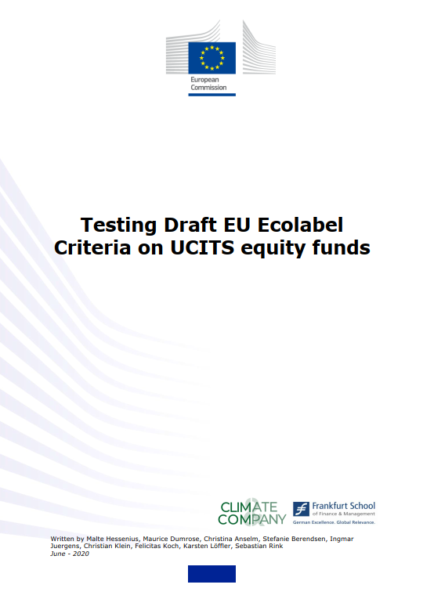
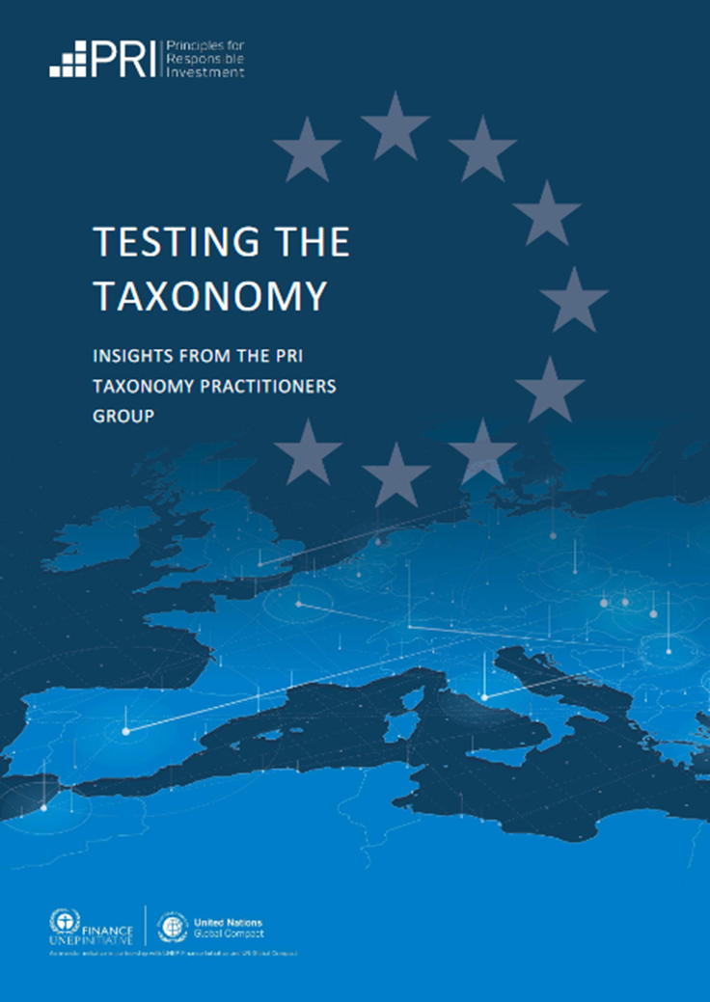
2
EU Taxonomy for Companies and Funds
Example 1: Test on 1,831 companies invested by 101 EU-domiciled “green” equity funds (June 2020)
Example 2: “Testing the Taxonomy: Insights from the PRI Taxonomy Practitioners Group” (Sept 2020)
14% of company revenues could not be mapped to Taxonomy
With improved company reporting, easier application of the EU Taxonomy will be possible
Shows 35 positive case studies describing their members’ experiences from applying the Taxonomy
Shows that PRI’s members from an array of disciplines already moving to lever the EU Taxonomy approach
Challenges & barriers:
Poor quality reporting & lack of data
For companies and funds, two regulations that use EU taxonomy definitions, are critical drivers:
Non-Financial Reporting Directive (NFRD) & Sustainable Finance Disclosures Regulation (SFDR)
Notes:
SFDR: Is supplemented by the EU taxonomy definitions and mandates investment firms and advisors to address the environmental sustainability of investments
Ensuring the availability of granular data through upgraded reporting (link to NFRD and the Sustain)
The development of practical guidance to provide clarity on the selection and exclusion of certain indicators and activities are ways to improve.

Slide 6
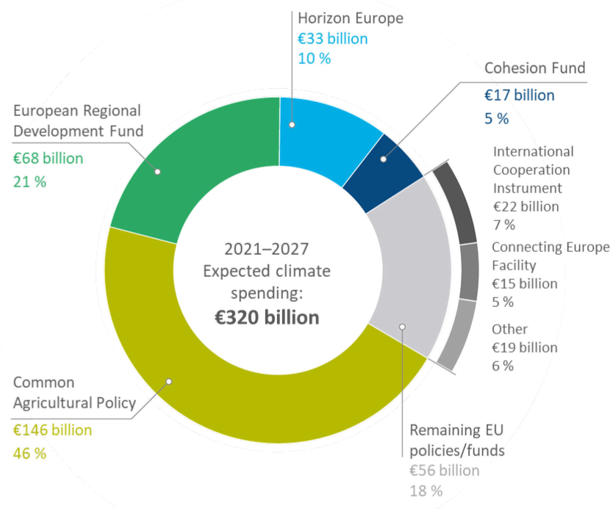
3
EU Taxonomy for public funds – we need a tracking methodology measuring materiality (“substantial contribution”)
Cohesion Policy
    Energy Efficiency renovation (100% coefficient, no substance)
    High-efficiency co-generation and district heating
    Among others
Agriculture
    Almost half of the climate spending but only <15% of EU’s GHG emissions
    Methodological flaws as highlighted by European Court of Auditors
    Negative impact on climate not taken into account
Source: ECA, based on Commission’s 2018 proposal

Slide 7
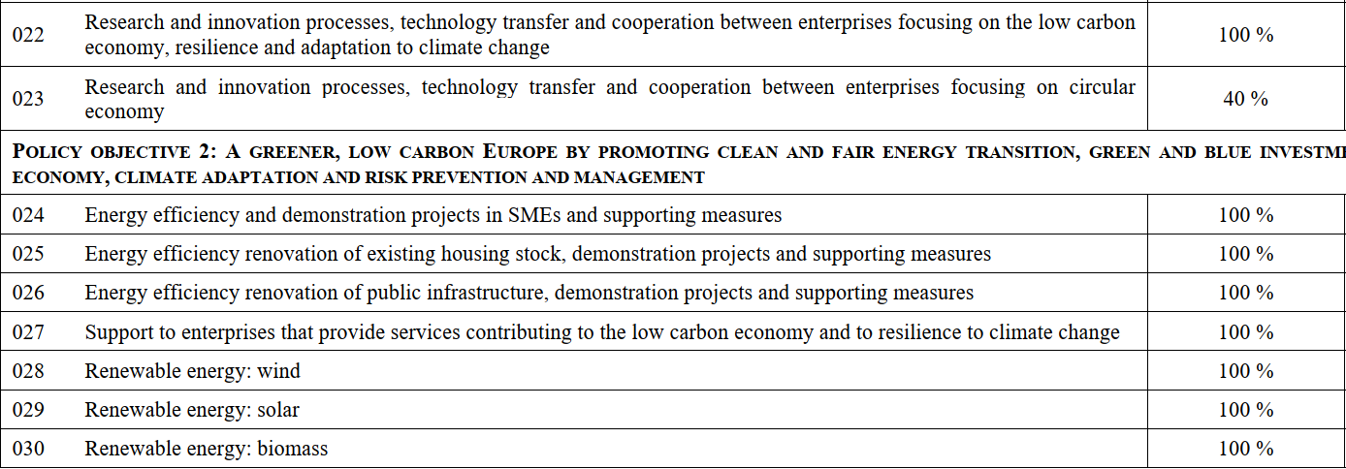
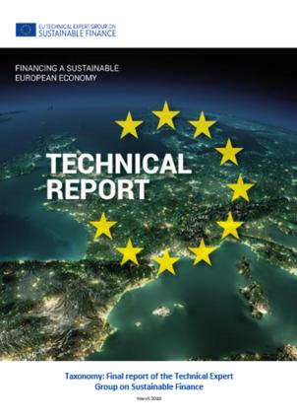
3
Exemplification: mapping EU Taxonomy criteria to currently used method
Rio Markers targeting “Cohesion Policy” (line by line)
Acknowledgement: For this section, we thank Christina Anselm from Frankfurt School of Finance for helpful contributions.

Slide 8
3
One precise examples on linking
the Rio Markers to the EU Taxonomy
Energy Efficiency
1
Investments in energy efficiency (project identified by the „EY study“)
Project
Rio Marker
Taxonomy
Suggestion
Accelerated reduction of energy intensity of Prague buildings
€111 mn
100 % climate coefficient [025 - Energy efficiency renovation of existing housing stock]
Only counts if primary energy demand is reduced by >30% of the building (or complies with BPED).
Use Taxonomy (stricter criteria that ensure contribution to CC mitigation)
More examples on district heating, renewables, etc…
Acknowledgement: For this section, we thank Christina Anselm from Frankfurt School of Finance for helpful contributions.

Slide 9
3
“Taxonomizing Rio Markers” - A temporary, second best solution but a pragmatic way forward? (1/2)
Advancing Rio Markers through Taxonomy thresholds
Rio Marker Category of Intervention
Climate Coefficient
Climate Coefficient
024 - Energy efficiency and demonstration projects in SMEs and supporting measure
100%
100% if the projects:
- concern the construction of new buildings with a net Primary Energy Demand (PED) that is at least 20% lower than the NZEB requirement (nearly zero-energy building, national directives);
- concern the renovation of buildings reduction of at least 30% PED […]
0% otherwise.
Acknowledgement: For this section, we thank Christina Anselm from Frankfurt School of Finance for helpful contributions.

Slide 10
3
“Taxonomizing Rio Markers” - A temporary, second best solution but a pragmatic way forward? (2/2)
Rio Marker Category of Intervention
Climate Coefficient
Climate Coefficient
034 -High efficiency co-generation, district heating and cooling
100%
100% if the projects:
-- co-generation: life cycle emissions are lower than 100gCO2e/kWh or heat/cool produced from waste heat;
- district heating/cooling: associated infrastructure follows the EU Energy Efficiency Directive;
[…]
0% otherwise.
Acknowledgement: For this section, we thank Christina Anselm from Frankfurt School of Finance for helpful contributions.

Slide 11
To conclude (and contextualize results…)
A)
In the absence of a taxonomy, financial markets already apply their own definitions of “green”and “sustainable”to both corporates and sovereigns.
B)
The EU should be in the driving seat and proactively shape these market standards
C)
This report provides sufficient evidence that the EU Taxonomy is already applicable today and can evolve as a dynamic framework
D)
As a second best and temporary solution, the currently proposed method (RRF regulation) must be adapted to avoid harmful lock-in effects and prohibit green washed recovery plans.

Slide 12
Find the report on:
https://www.climateandcompany.com/applying-eu-taxonomy
Thanks a lot!
Malte Hessenius
malte@climcom.de

Slide 13
Backup Slides

Slide 14
Conversion from the Common Regulation COM(2018) 375
Aggregation of suggestion
Not covered by the Taxonomy:
Overview Evaluation
Final Evaluation | Count | Percentage
No climate relevance | 71 | 50%
Use Taxonomy | 61 | 43%
Neither frameworks work | 8 | 5%
Use Rio Marker | 3 | 2%
SUM | 143 | 100%
ID | Intervention Field Dimension | Rio Markers Climate coefficient
048 | Air quality and noise reduction measures | 40%
130 | Protection, development and promotion of natural heritage and eco-tourism | 0%
139 | Outermost regions: airports | 0%
    Intervention field dimensions
      In close to 50%, no climate relevance
      We recommend the application of the EU Taxonomy over the Rio Markers for approximately 40%
      We suggest that that neither Rio Markers nor the EU Taxonomy should be used for roughly 5-6%
For only 3 cases, or roughly 2%, we recommend the application of the Rio Markers over the EU Taxonomy.

Slide 15

Does the current tracking method cover
all dimensions of a (green) RRP?
No, it does not…
Sector
EU GHG emissions
RIO
Taxonomy
EU climate spending (2014-20)¹
EU climate spending (2021-27) ²
> 90% emissions
EEA data (2017)
Own assessment
Source: ECA, IEEP and own assumptions¹
Energy
~ 29%
✔
✔✔
~ 5-10%
~ 5-10%
Transport
~ 22%
✔
✔✔
~10-15%
~ <10-15%
Industry
~ 20%
N/A
✔✔
< 3%
< 3%
Buildings
~ 13%
✔
~ 5-10%
~ 5-10%
Agriculture
~ 12%
✔
~ 50%
~ 46%
Notes: 1) Estimates derived from facilities with biggest „climate contribution“ (CAP, ERDF, CF, Horizon); 2) based on COM proposal from 2018
Notes:
Energy Efficiency renovation (100% coefficient, no substance)
High-efficiency co-generation and district heating
Among others
Almost half of the climate spending but only <15% of EU’s GHG emissions
Methodological flaws as highlighted by European Court of Auditors
Negative impact on climate not taken into account

Slide 16

How to apply the EU Taxonomy to
public stimulus measures?
Some examples from the German stimulus package
Recipient of RRF money
Examples
Taxonomy evaluation
Projects/ Companies
Energy efficiency programs
Relevant SME activities¹
[…]
Households
Premium for e-vehicles
Reduction in consumer tax
[…]
Subsidies for public transport
?
Municipalities
Investment plan sports facilities
[…]
Notes: 1) for instance taxonomy-aligned program by KfW “Climate protection offensive for SMEs” (link)
Notes:
Projects-companies: Relatively straight-forward. Does the project fall under the scope of the Taxonomy? If so, does it comply with the screening criteria?
Households: for e-vehicles it is eligible. For others: “no climate relevance”
Municipalities: Should be possible. May requires some thinking. E.g. public transport - Share of renewable energy in transport fuel consumption

Slide 17
2
Applying the EU Taxonomy for
climate tracking: Practical examples
Applying the EU Taxonomy depends upon whom you are and which type of investment is being assessed.
Put simply, an activity – which can be a project or investment – should meet this criteria:
Fund manager, bond issuer, project financier or Government
Project or asset, share portfolio or capital investment budget
1. ELIGIBILITY:
Activity fits a defines NACE macro-sector category for climate mitigation or adaptation
2. ALIGNMENT:
Activity must make a substantial contribution defined by a threshold in climate mitigation or adaptation
3. DNHS:
Do No Significant Harm to the other five EU environmental objectives
4. COMPLIANCE:
Comply with minimum safeguards

Slide 18
EU Taxonomy implementation timeline
can support EU recovery investments
  Taxonomy
  Benchmark
  Disclosures
9 Mar, Publication: Usability guide with a proposal for the EU green bond standard
9 Dec, Official Text: Amendments to benchmarks regulation concerning Climate Benchmarks
18 Jun, Publication: TEG report on EU Taxonomy
5 Dec, Agreement: Political agreement on EU Taxonomy
9 Dec, Official Text: Sustainability-related Disclosures Regulation published in EU Official Journal
29 Dec, In Force: Sustainability-related Disclosures Regulation
Q4, Official Text: Commission will take a decision in on how to take the Green Bond Standard forward.
1 Dec, In Force: Climate Mitigation and Climate Adaptation sections of EU Taxonomy
End 2020, Official Text: Amendment to MiFID II to integrate sustainability risks into sustainability assessment
End 2020, Publication: Draft Delegated Acts specifying technical standards on climate and environment-related impacts for Sustainability-related Disclosure Regulation
End 2020, Launch: Platform on Sustainable Finance (replacing TEG, after Taxonomy regulation is approved)
1 Jan, Application: Administrators of significant benchmarks to endeavour to provide one or more EU Climate Transition Benchmarks
1 Jan, In Force: Transparency requirements for annual reports (Sustainability-related Disclosure Regulation)
Q2, Official Text: Usability guide with a proposal for the EU green bond standard
30 Apr, Application: Benchmarks regulation on Climate Benchmarks ESG Disclosures
30 Jun, In Force: Fuller Transparency disclosure for larger market participant under Sustainability-related Disclosure Regulation
Q1
Q1
Q2
Q3
Q4
Q1
Q3
Q4
Q1
Q4
2019
2020
2021
2022
1 Jan, In Force: Transparency requirements for annual reports (Sustainability-related Disclosures Regulation)
Mar, Publication: TEG final report on EU Taxonomy
Mid 2020, Official Text: Delegated Acts specifying minimum standards for Climate Benchmarks ESG Disclosures
1 Jan, Application: Delegated acts specifying which sectors to exclude from Paris-aligned Benchmarks
10 Mar, Application: Majority of obligations under Sustainability-related Disclosure Regulation
1 Dec, Application: Climate Mitigation and Climate Adaptation sections of EU Taxonomy
1 Dec, In Force: Remainder of EU Taxonomy
31 Dec, Publication: Draft Delegated Acts specifying technical standards on social and employee matters, human rights, anti-corruption/bribery matters for Sustainability-related Disclosure Regulation
1 Dec, Application:
Remainder of EU Taxonomy
Source: Sustainalytics, 2020

Slide 19
Timings of Recovery and Resilience Plans
fits EU Taxonomy Regulation
RRPs can be submitted in the first two years of implementation (until 2022) by 30 April of each year.
It will also be possible up to 2024 if funding is available, and based on a call from the EC
16 August, the Recovery and Resilience Task Force (RECOVER) was set up to lead implementation of the RRF
9 September, European Court of Auditors publishes an opinion concerning the Commission proposal on the Facility
28 May, Commission adopts a proposal for a regulation of the European Parliament and of the Council establishing a Recovery and Resilience Facility (RRF)
30 April, The deadline for the submission of RRPs
Q1
Q2
Q3
Q4
Q1
Q2
Q3
Q1
Q1
2020
2021
2022
2024
15 October, MS are encouraged to submit their preliminary draft Recovery and Resilience Plans (RRPs)
1 Jan, MS will be able to present their RRPs plans formally for assessment once the Facility comes legally into force
Graph created by CS based on data from the European Parliament, 2020

